Slide 1
Fast Track to F#
Closing

Slide 2
Learning pyramid
Lecture
Reading
Teaching others
Audio-visual
Demonstration
Practice by doing

Slide 3

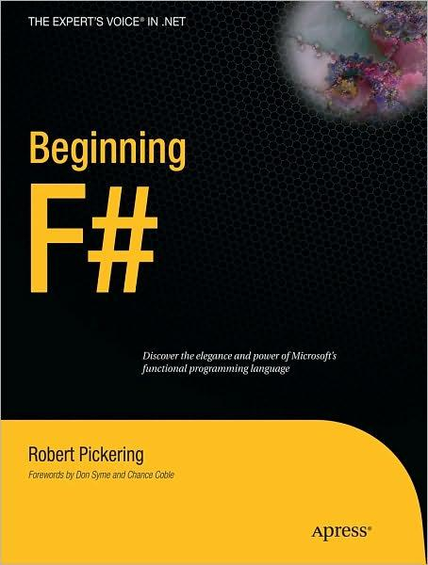








F# Books

Slide 4
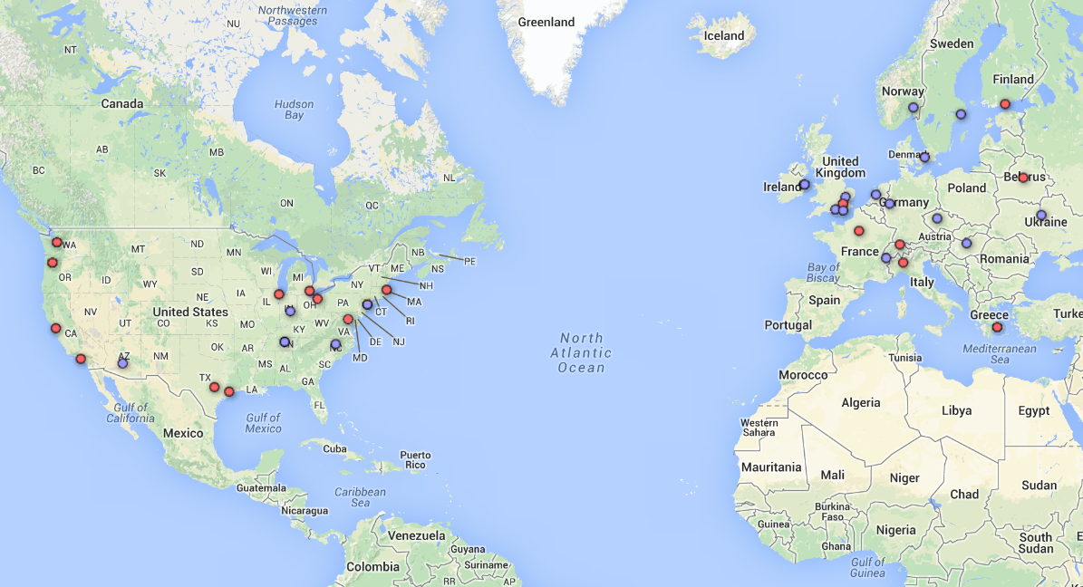
Join user groups
http://c4fsharp.net/groups.html

Slide 5




Community
Every 2 week @ Skills Matter
http://meetup.com/fsharplondon
Every month or so in Brighton
http://meetup.com/functional-brighton
Around the UK
http://www.nxtgenug.net/
Around the UK
http://developerdeveloperdeveloper.com/

Slide 6
Community
Community
Events
Tweet with #fsharp
@brandewinder
@ptrelford
@rachelreese
@rickasaurus
@ScottWlaschin
Snippet sharing
www.fssnip.net
F# Works workshops
EU, USA and worldwide
www.fsharpworks.com
Progressive F# tutorials
London, New York
www.skillsmatter.com
Community for F#
Online events & materials
www.c4fsharp.net

Slide 7

Thanks for joining the course!
Contact details
Email: info@fsharpworks.com
Web: http://tomasp.net
& fsharpforfunandprofit.com
@tomaspetricek
@ScottWlaschin
Need more help?
F# consulting, developent and support
http://fsharpworks.com | info@sharpworks.com

